Slide 1
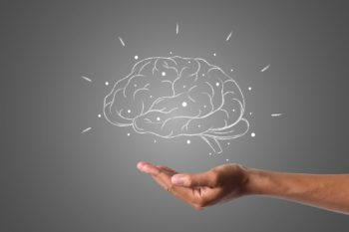

Comprehensive Classification of Depressed Patients using Machine Learning Techniques and Outcome Assessment
Birla Institute of Technology, Mesra, Patna campus
Submitted by:
Name: Krishna Kant
Roll: BTECH/15051/20
Branch: Computer Science & Engineering
Guide : Mr. Sujit Kumar Chatterjee Coordinator : Dr. Subhash Chandra Pandey
Assistant Professor Assistant Professor

Slide 2
Index
Abstract
Introduction
Existing System & Existing work
Motivation For works
Proposed System
Advantages of Proposed System
System Configuration
System Architecture
Methodology
Algorithms used
Classification scores for all the models
Input & Output
Results
Conclusion
References

Slide 3

Abstract
The Problem in my hand was Comprehensive Classification of Depressed Patients using Machine Learning Techniques and Outcome Assessment.It analyzed a unique dataset & the dataset was comprises of motor activity recordings from depressed patients (unipolar, bipolar) and a control group(normal patients).
Wearable sensor technologies are increasingly popular for tracking human activity beyond traditional metrics like interviews of patients with doctor & PHQ scores(scale to measures level of depression) .
I have used Machine learning models like Random Forest Classifier & Decision Tree Classifier for solving this problem . I used these algo./models to classified individuals into depressed and non-depressed groups based on activity data & predicted depression level of patients, afftype(bipolar,unipolar), patient status(based on MADRS1 scores), post-treatment score(MADRS2), post-treatment improvement, marital and work status of patients.
I have analyzed the impact of model predictions on gender, afftype, work status, marital status, melancholic/non-melancholic status, and patient status. Specific model analyses revealed the distribution of patients across depression levels, types, improvement in condition, and classification based on expected characteristics.
I have expanded dataset size using Genetic algorithms ( CrossOver technique), enabling assessment of all eight machine learning models' generalizability. Comparative studies between original and augmented datasets provided insights into model performance and reliability across varying data volumes.
The methods involved in this project are Exploratory Data Analysis(Data preprocessing & Data visualization),Cross-Validation(train_test_split),Normalisation(MinMax Scaling & Standardization)Training & testing and finally prediction.

Slide 4

Introduction
Introduction:
- Dramatic change in monitoring human behavior with wearable sensor technologies
- Beyond typical step and calorie tracking, includes continuous heart rate and activity level recordings
Mental Health Evaluation:
- Exploration of a distinct dataset from individuals battling depression
- Motor activity recordings from 32 healthy controls and 23 patients with unipolar and bipolar depression
Connection Between Activity Data and Mental Health:
- Utilization of machine learning to classify people into depressed and non-depressed states using Random Forest and Decision Tree models
Characteristics of Depression:
- A serious mental illness causing symptoms like melancholy, worry, trouble sleeping, and loss of interest in activities
- Hereditary foundations contribute to the complexity of bipolar and unipolar diseases

Slide 5
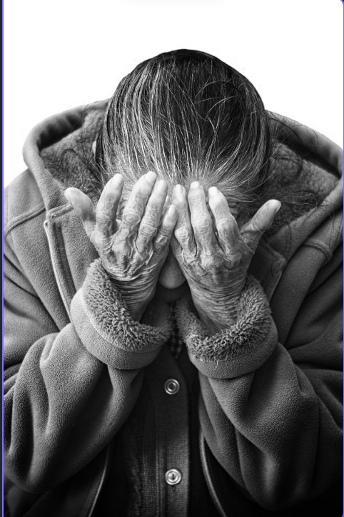
Continued...
Global Impact of Depression According to WHO:
Prevalence: Global prevalence of depression affecting 5% of adults worldwide according to WHO.
Contribution to Burden of Disease: Explanation of depression's significant contribution to disability and the overall burden of disease globally.
Challenges in Depression Treatment
Limited Services: Description of the challenges in depression treatment, particularly the lack of adequate services in low and middle-income nations.
Treatment Gap: Highlighting the statistic that over 75% of individuals with mental illnesses in these countries do not receive treatment.
Significance of Depression:
Global Impact: Overview of depression affecting 15% of people worldwide.
Observation Tool: Recognition of actigraph recordings of motor activity as a valuable tool for ongoing observation and evaluation of depression using ml techniques.

Slide 6

Continued
Types of Depression
1.Major Depressive Disorder (MDD):
Definition: Clinical depression or unipolar disorder.
Characteristics: Persistently melancholic mood affecting daily activities and interests.
Symptoms:Include depressed mood, lack of interest, changes in weight, fatigue, feelings of guilt, concentration loss, and thoughts of death or suicide.
Diagnosis: If a person experiences most symptoms for over two weeks, MDD is diagnosed.

Slide 7
Continued...
2.Persistent Depressive Disorder (PDD):
Definition: Chronic depression lasting for at least two years, formerly known as dysthymia.
Severity: Can be mild, moderate, or severe.
Relief Periods: Brief relief periods, lasting two months or less.
Symptoms: Widespread and persistent, not as severe as major depressive disorder as ex: Sad sentiments, Loss of enjoyment and interest, Anger and agitation, Guilt, Low self-esteem, Sleep issues, Exhaustion and low vitality, Appetite changes, Difficulty in focusing.
Treatment: Involves psychotherapy and medication.

Slide 8
Continued..
3.Bipolar Disorder :
Manic episodes, also known as periods of unusually elevated mood, are the hallmark of bipolar disorder.
These episodes can range from mild (hypomania) to severe enough to seriously impair a person's life, necessitate hospitalisation, or impair their perception of reality.
Major depressive episodes occur in almost all bipolar disorder patients.People with depression frequently experience a variety of physical and emotional symptoms, in addition to their depressed mood and noticeably decreased interest in activities.
Symptoms may include:Lethargy, sleeplessness, and fatigue,Unknown aches, pains, and agitation in the psychomotor domain ,Desperation,Lack of focus.

Slide 9

Continued..
4.Postpartum Depression:
Significant hormonal changes that can occur during pregnancy can frequently have an impact on a woman's mood.
Depression can start during or after a pregnancy and the birth of a child.
Duration:long lasting for two weeks after the birth of a child.
Symptoms: mood swings, anxiety, irritability,.

Slide 10

Continued..
Causes Of Depression:
Depression can arise from a multitude of factors such as genetic, environmental, psychological, and biochemical ones. A person is more likely to experience depression if they have trauma, significant life changes, stress, a family history of depression, certain physical illnesses (like diabetes, cancer, or Parkinson's disease), or as a side effect of certain medications.

Slide 11
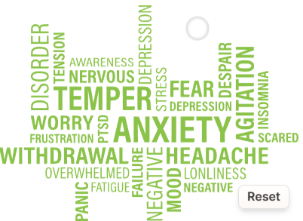
Continued..
Montgomery–ÅsbergDepression Rating Scale (MADRS):
Purpose: Widely used for measuring depression, especially in antidepressant efficiency trials.
Method: Relies on a clinical interview conducted by an interviewer.
Scoring Factors:
Apparent Sadness
Reported Sadness
Inner Tension
Reduced Sleep
Reduced Appetite
Concentration Difficulty

Slide 12
Lassitude(lack of energy)
Inability to Feel
Pessimistic Thoughts(negative thoughts/thinking)
Suicidal Thoughts
Scoring System: A 10-item clinician-rated measure with a maximum total score of 60 points.
Interpretation:
0 to 6: Not depressed
7 to 19: Mild depression
20 to 34: Moderate depression
35 and higher: Severe depression
60 or higher: Very severe depression

Slide 13

Existing System & Existing Work
Walsh and colleagues (2018): Introduced a novel method for gait recovery using wearable lower limb haptic feedback, based on a randomized controlled trial (RCT) involving 60 patients at high risk of falls.
Osmani (2015): Proposed a smartphone-based approach to detect periods of mania and depression, leveraging smartphone data.
Schueller et al. (2015): Conducted an exploratory investigation into the relationship between depressive symptoms and mobile phone sensor data.
Davatzikos and Koutsouleris (2014): Explored the application of machine learning for psychiatric disease classification.
Onaral and Xing (2012): Discussed patient perspectives on wearable and implantable sensors without referencing specific studies or sample sizes.
Chan et al. (2012): Provided an overview of wearable technology and rehabilitation systems, outlining potential applications.
Musolesi and Canzian (2015): Investigated depression trajectories through smartphone movement traces, contributing to mental health research.
Iniesta et al. (2016): Explored the future of biological research in psychiatry, emphasizing machine learning integration without specific study details.
Meyer-Lindenberg and Bzdok (2018): Discussed precision psychiatry's prospects and challenges using machine learning, without specifying research studies or sample sizes.
Zhang et al. (2017): Examined personal sensing and machine learning for mental health understanding, stressing the importance of technology integration for personalized care.

Slide 14

Motivation For Works
Understanding Depression's Impact: Acknowledgment of depression's profound effects on individuals and society globally. Recognition of the limitations in traditional diagnostic methods and tracking.
Revolutionizing Mental Health Assessment: Integration of wearable sensor technologies with machine learning models for real-time, continuous monitoring.
Contribution to Digital Mental Health:A greater dedication to developing the field of digital mental health serves as the driving force behind this work. Through investigating the potential benefits of wearable technology and machine learning, the project hopes to add to the increasing amount of research on cutting-edge technological approaches for enhancing mental health outcomes.
Addressing the Complexity of Depression: Addressing the Complexity of Depression:Depression is a multifaceted disorder with various contributing factors. Wearable sensors and machine learning present an opportunity to address this complexity.The motivation is rooted in the desire to unravel the intricate relationships between continuous activity data and mental health, potentially uncovering novel insights that contribute to a more holistic understanding of depression.

Slide 15

Proposed System
1. Data Preparation and Exploration:
Conducted thorough data cleaning, preprocessing, and exploratory data analysis (EDA) on both the original and enhanced dataset sizes.
Addressed missing values using statistical measures like mean, median, and mode.
Ensured compatibility of different data types for subsequent analysis.
Utilized the ceil function to round off numerical attributes for consistency.
Eliminated unnecessary characteristics to enhance model performance and reduce computational complexity.
Discretized continuous values into categorical ones through label encoding.
Utilized the RandomOverSampler technique for oversampling to address class imbalance issues.
Divided the data into target and training sets, reserving a portion for model testing.
Employed standardization approaches like StandardScaler and MinMaxScaler to bring data to a uniform scale.
2. Model Creation:
Utilized diverse supervised learning algorithms such as Random Forest and Decision Tree to create unique sub-models tailored to study goals.
Used accuracy, precision, recall, and F1 score to assess model performance.
Revealed insights into how well each model captured underlying patterns in the data.
3. Dataset Expansion and Comparative Analysis:
Augmented dataset size using Genetic algorithms with CrossOver technique.
Applied all eight machine learning prediction models to the synthetic dataset to assess generalizability.
Conducted comparative studies between original and expanded datasets to understand model performance and reliability.
Analyzed the influence of model predictions on various characteristics, including gender, afftype, work status, marital status, melancholic/non-melancholic status, and patient status.
Investigated distribution of patients across depression levels, types, improvement in condition, and classification based on expected characteristics.

Slide 16
Dataset Details
The dataset was originally collected for the study of motor activity in schizophrenia(skitsafrenea :one of the mental disorder) & major depression https://bmcresnotes.biomedcentral.com/10.1186/1756-0500-3-149.
Motor activity was monitored with an actigraph watch worn at right wrist(Actiwatch,Cambridge Neurotechnology).This watch measures activity levels.
This dataset folder was consist of dataset file scores.csv and MADRS scores are available in this datafile(scores.csv ).
The scores.csv dataset consist of following attributes/features:
patient identifier(number)
The number of measurement Days.

Slide 17
Continued.....
3.The gender(1 or 2 for female or male).
4.The age(age in age groups).
5.The afftype(1:bipolar ii,2:unipolar depressive,3:bipolar i).
6.The melancholy(1:melancholia,2:no melancholia).
7.The inpatient(1:inpatient,2:outpatient).
8.The edu(education grouped in year).
9.The marriage(1:married or cohabiting,2:single).
10.work(1:working or studying,2:unemployed/sick leave/pension).
11.madrs1(MADRS score when measurement started).
12.madrs2(MADRS when measurement stopped).
Note:-In features selection process i have eliminated unnecessary features like edu and patient identifier.

Slide 18
Continued..
Proposed Models:
I have proposed eight machine learning models to classify the depressed patients.These are:
MACHINE LEARNING MODEL NO 1: “Created Machines Learning model for Predicting the MADRS1 score of persons/patients and on the basis of that score signify the level of depression in person/patients.”
The features used for model training are :days,age,gender,afftype,melanch,inpatient,marriage and work.
MACHINE LEARNING MODEL NO 2: “Created Machines Learning model for Predicting the MADRS 2 score of persons/patients and on the basis of that score signify the level of depression in person/patients.”
The features used for model training are :days,age,gender,afftype,melanch,inpatient,marriage work and MADRS1.
MACHINE LEARNING MODEL NO 3:“Machine Learning Classification of Depression Types: Differentiating Bipolar II, Unipolar Depressive, and Bipolar I Disorders for Personalized Treatment Strategies”.
The features used for model training are :days,age,gender,melanch,inpatient,marriage ,work and MADRS1 .
MACHINE LEARNING MODEL NO 4:“Predicted Treatment Outcomes in Depression: A Machine Learning Approach for Assessing Patient Improvement”.For this model i had add new attributes or features in dataset that is result=[MADRS2-MADRS1].
The features used for model training are :days,age,gender,afftype,melanch,inpatient,marriage ,work , MADRS1 and MADRS2.
MACHINE LEARNING MODEL NO 5:“ Applied machine learning classification models to classify a patient's condition as melancholic or non-melancholic.”
The features used for model training are :days,age,gender,afftype,inpatient,marriage ,work , MADRS1 and MADRS2 .

Slide 19
Continued..
MACHINE LEARNING MODEL NO 6:“ Utilized machine learning classification models to classify a patient's work status (1: working or studying, 2: unemployed/sick leave/pension).”
The features used for model training are :age,days,gender,afftype,inpatient,marriage , MADRS1 and MADRS2 .
MACHINE LEARNING MODEL NO 7:“ Utilized machine learning classification models to classify a patient's marital status (1: married or cohabiting, 2: single).”
The features used for model training are :age,days,gender,afftype,inpatient,work , MADRS1 and MADRS2 .
MACHINE LEARNING MODEL NO 8:“ Used machine learning classification models to determine whether a patient is an inpatient or outpatient.”
The features used for model training are :age,days,gender,afftype,work , marriage,MADRS1 and MADRS2 .
These above are the proposed eight machine learning model to Classify Patients whether They are depressed or not and if they are depressed then what’s the level of depression on the basis of MADRS_score2-MADRS_score1.
On the basis of MADRS score1 and some others attributes i had Classified :
The work of person
Afftype(unipolar,bipolar1,bipolar2) of patients
Patient’s martial status
Patient’s is inpatient or outpatients
Melanch(loneliness) or not

Slide 20
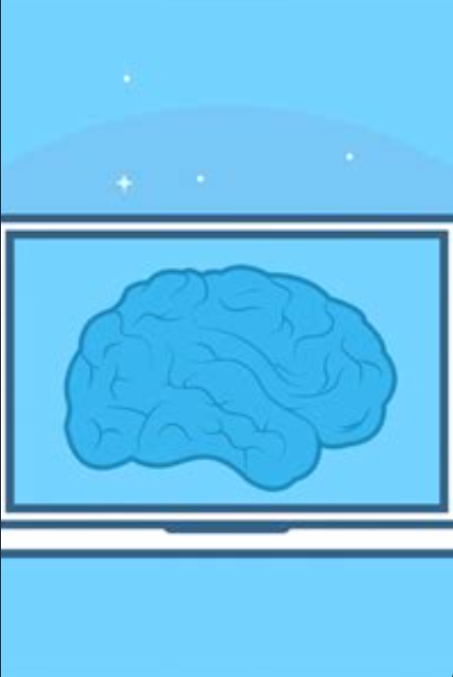
Advantages of Proposed System
Provides a quantitative prediction of MADRS1 scores for individuals.
Enables a continuous assessment of depression severity.
Offers personalized insights into the level of depression.
Facilitates personalized treatment strategies based on depression types.
Enhances diagnostic precision by categorizing into Bipolar II, Unipolar, and Bipolar I.
Provides tailored approaches for different depressive conditions.
Predicts outcomes(improvement of patients condition) by considering the difference between MADRS2 and MADRS1.
Offers insights into the effectiveness of treatment interventions.
Enables personalized adjustments in treatment plans.
Classifies patients into melancholic or non-melancholic conditions.

Slide 21
Helps in understanding specific characteristics and needs of melancholic patients.
Guides personalized therapeutic approaches.
Classifies patients based on work status (working/studying or unemployed).
Assists in understanding the impact of depression on occupational activities.
Classifies patients based on marital status (married/cohabiting or single).
Addresses the influence of marital status on mental health.
Contributes to personalized care based on the patient's status.
Enhances diagnostic accuracy and precision in depression assessment.
Provides a comprehensive and individualized approach to mental health.
Guides personalized treatment and intervention strategies.
Offers valuable insights into various aspects of depression, including severity, afftype, and outcomes.
Facilitates continuous monitoring and data-driven decision-making in mental health care.

Slide 22

System Configuration
Hardware requirements:
Processer : Any Updated Processer
Ram : Min 4GB
Hard Disk : Min 100GB
Software requirements:
Operating System : Macos family
Technology : Python3.7
IDE : Juptyer notebook

Slide 23
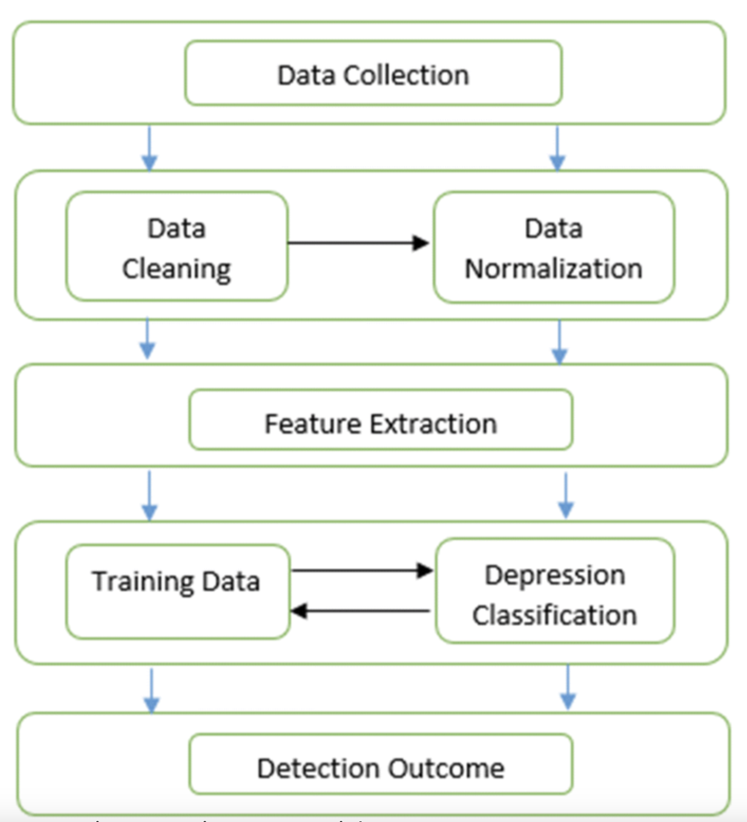
System Architecture

Slide 24
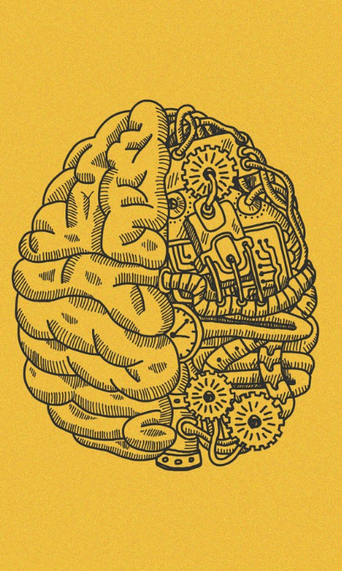

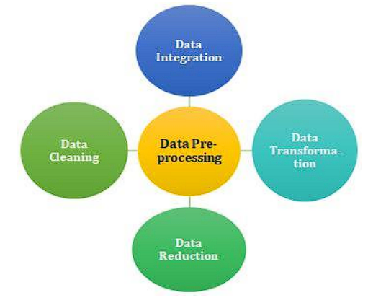
Methodology
Data Preprocessing

Slide 25
Continued..
Data preprocessing is a crucial step in the machine learning pipeline that involves transforming raw data into a suitable format for training and building predictive models. It helps to improve the quality and reliability of the data and enhances the performance and accuracy of the machine learning algorithms. Data preprocessing typically includes the following steps:
Data Cleaning:
Handle missing values: Identify and deal with missing data points, either by imputation (filling in missing values) or removing the corresponding rows or columns.
Remove duplicates: Check for and remove duplicate records in the dataset, as they can lead to biased model training.
Data Transformation:
Feature Scaling: Scale numerical features to a common range (e.g., normalization or standardization) to prevent features with larger magnitudes from dominating the model training process.
Encoding Categorical Variables: Convert categorical features into numerical representations (e.g., one-hot encoding or label encoding) that machine learning algorithms can process.

Slide 26
Continued..
Data Reduction:
Dimensionality Reduction: Use techniques like Principal Component Analysis (PCA) or t-distributed Stochastic Neighbor Embedding (t-SNE) to reduce the number of features while retaining the most critical information.
Feature Selection: Select the most relevant features that contribute significantly to the prediction task, thereby simplifying the model and reducing computation time.
Data Splitting:
Divide the dataset into training and testing subsets to evaluate the model's performance accurately. The training set is used for model training and the testing set for final evaluation.

Slide 27
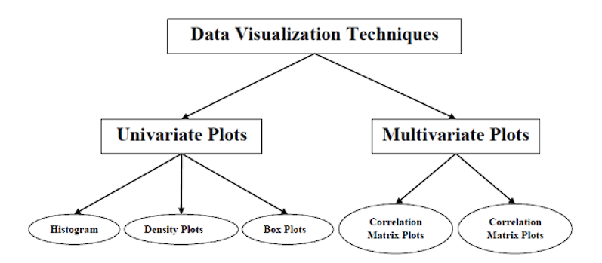
Continued..
Data Visualization

Slide 28
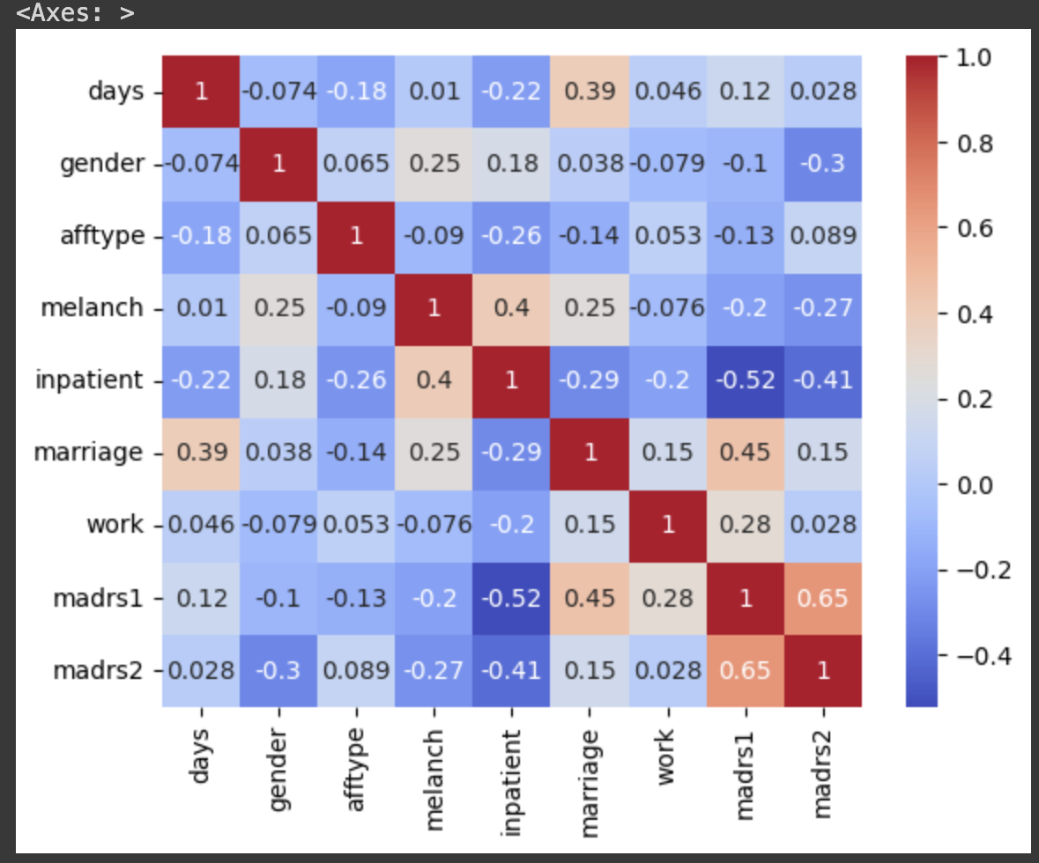
Continued..
Example of a heatmap(correlation matrix)

Slide 29
Continued..
Data visualization in machine learning involves the use of graphs, charts, and other visual representations to gain insights, explore patterns, and communicate findings in the dataset. It plays a vital role in understanding the data's characteristics, identifying relationships between variables, and making informed decisions during the model building process. Here are some key aspects of data visualization in machine learning:
Exploratory Data Analysis (EDA):
Data visualization is an essential step in EDA, which involves visually inspecting the dataset to understand its structure, distributions, and potential patterns.
Histograms, box plots, scatter plots, and density plots are common visualization tools used to examine the distribution and relationships between variables.
Feature Visualization:
Visualizing the features and their relationships can provide insights into which variables might be relevant for the machine learning model.
Correlation matrices or heatmaps can show the pairwise correlations between features, helping to identify highly correlated or redundant variables.

Slide 30
Continued..
Target Variable Analysis:
Visualizing the distribution of the target variable is crucial for understanding the problem's nature and identifying any class imbalances in classification tasks.
In regression tasks, scatter plots or regression lines can help visualize the relationship between the target variable and independent variables.
Model Performance Visualization:
After training the machine learning model, visualizations of model performance metrics (e.g., accuracy, precision, recall, F1-score) can aid in assessing the model's effectiveness.

Slide 31
Cross-Validation
Cross-validation is a resampling technique used in machine learning to evaluate the performance of a model and assess its generalization ability on unseen data. It helps to overcome issues like overfitting or underfitting by providing a more reliable estimate of the model's performance. Cross-validation involves splitting the dataset into multiple subsets, training the model on different combinations of these subsets, and then evaluating its performance on the remaining data.
The process includes :
Data Splitting:
The original dataset is divided into "k" equally-sized or nearly equally-sized folds (subsets).
Training and Validation:
The model is trained k(we are taking k as 2) times, each time using different combinations of "k-1" folds as the training data and the remaining fold as the validation (test) data.

Slide 32
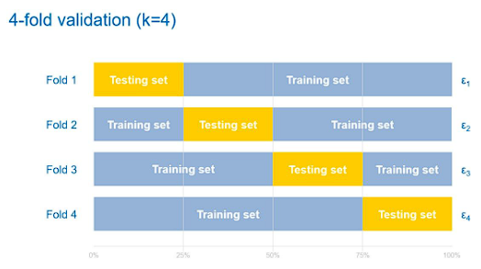
Continued..
For example, in 5-fold cross-validation, the dataset is divided into 5 subsets. The model is trained 5 times, each time using 4 folds for training and 1 fold for validation.
Performance Evaluation:
The performance metrics (e.g., accuracy, precision, recall, F1-score, R2 score) are computed for each fold, providing an average performance metric across all "k" runs.
The average performance metric is a more reliable estimate of the model's performance compared to a single train-test split.

Slide 33
Continued..
Benefits of Cross-Validation:
Provides a more reliable estimate of the model's performance, as it averages the results over multiple folds.
Helps in selecting hyperparameters for the model, as it reduces the risk of hyperparameter tuning based on a specific train-test split.
Offers a better understanding of the model's generalization ability on unseen data.

Slide 34

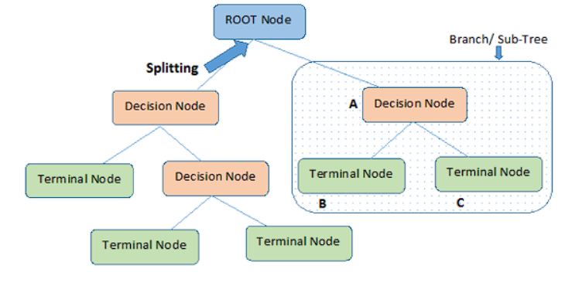
Algorithms used
Decision Tree

Slide 35
Continued..
A decision tree is a popular supervised machine learning algorithm used for both classification and regression tasks. It works by creating a tree-like model of decisions and their possible consequences based on the features (attributes) of the data.
Each internal node of the tree represents a decision based on a specific feature, and each leaf node represents a class label (in classification) or a numerical value (in regression).
Decision trees are widely used due to their simplicity, interpretability, and ability to handle both categorical and numerical data.
Working of Decision Trees :
Tree Construction:
The algorithm starts with the entire dataset at the root node.
It evaluates different features based on a specific criterion (e.g., Gini impurity for classification or mean squared error for regression) to determine the best feature to split the data at each node.

Slide 36
Continued..
The dataset is partitioned into subsets at each internal node, based on the selected feature's values.
The process continues recursively until a stopping criterion is met, such as reaching a maximum depth or having a minimum number of samples per leaf.
Decision Making:
To make predictions, a new data point traverses the decision tree from the root node to a leaf node, following the decisions made during the training phase.
The predicted class label (for classification) or numerical value (for regression) at the leaf node is the output of the decision tree.

Slide 37
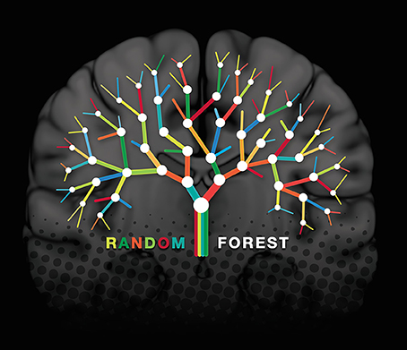
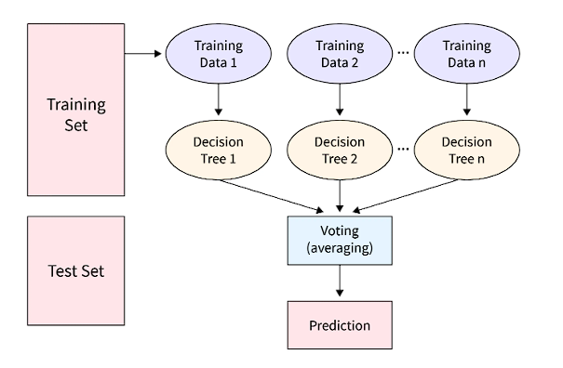
Continued..
Random Forest

Slide 38

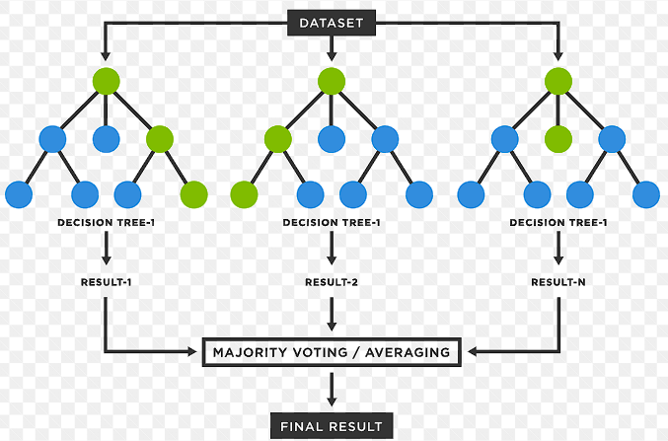
Continued..
Random Forest is a powerful ensemble learning method widely used in machine learning for both classification and regression tasks.
It is an extension of the decision tree algorithm and operates by creating multiple decision trees during training and combining their predictions to improve accuracy and reduce overfitting.
Random Forest is known for its robustness, high accuracy, and ability to handle large and complex datasets.

Slide 39
Continued..
Working of Random Forest :
Bootstrapping:
Random Forest builds multiple decision trees using a process called bootstrapping or bagging. For each tree, a random subset of the original dataset is sampled with replacement to create a new training set of the same size as the original data.
Feature Randomness:
At each node of the decision tree, only a random subset of features (variables) is considered for splitting. This introduces additional randomness and diversity among the trees, reducing the risk of overfitting.
Tree Building:
Each decision tree in the Random Forest is built using the bootstrapped dataset and a subset of randomly selected features.

Slide 40
Continued..
The decision trees grow until a stopping criterion is met, such as reaching a maximum depth or having a minimum number of samples per leaf.
Voting (Classification) or Averaging (Regression):
For classification tasks, the Random Forest combines the predictions of all the individual decision trees through majority voting to determine the final class label.
For regression tasks, the predictions of all trees are averaged to obtain the final output.

Slide 41
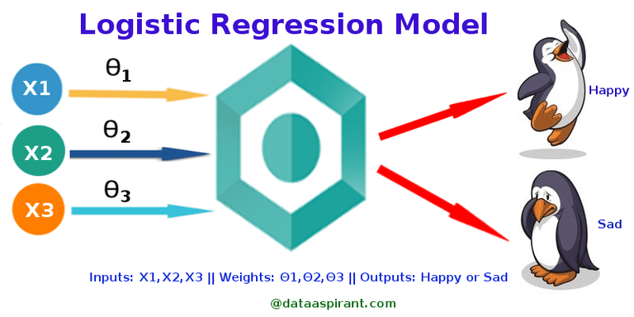
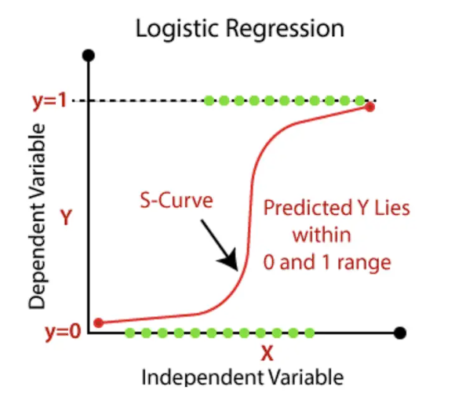
Continued..
Logistic Regression

Slide 42
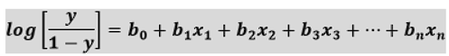
Continued..
Logistic Regression is a popular and widely used machine learning algorithm primarily used for binary classification tasks.
Despite its name, logistic regression is a classification algorithm, not a regression algorithm.
It models the probability of a binary outcome (e.g., 0 or 1, true or false, yes or no) based on one or more predictor variables (features).
Logistic Regression is well-suited for problems where the dependent variable is categorical and can take one of two classes.
Equation of logistic regression:
Equation of straight line:
In Logistic Regression y can be between 0 and 1 only, so for this let's divide the above equation by (1-y):
But we need range between -[infinity] to +[infinity], then take logarithm of the equation it will become:

Slide 43
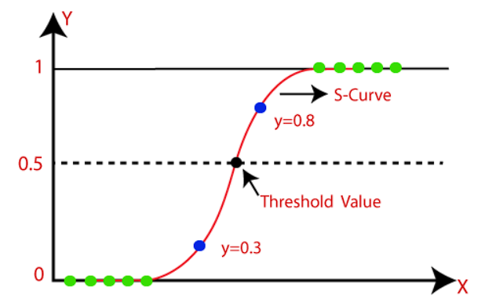
Continued..
Working of Logistic Regression:
Logistic Function (Sigmoid):
Logistic Regression uses the logistic function (sigmoid function) to map any real-valued number to a value between 0 and 1.
The sigmoid function is represented as: f(z) = 1 / (1 + exp(-z)), where "z" is the linear combination of the feature values and their corresponding coefficients.

Slide 44
Continued..
Modeling Probabilities:
In logistic regression, the output is the probability of the target variable belonging to the positive class (class 1).
The probability is calculated as the output of the sigmoid function applied to the linear combination of the feature values and coefficients.
Decision Boundary:
To make predictions, a threshold (typically 0.5) is used. If the predicted probability is greater than the threshold, the data point is classified as class 1; otherwise, it is classified as class 0.
Training the Model:
The coefficients (weights) of the logistic regression model are determined during the training phase using optimization techniques like maximum likelihood estimation or gradient descent.
The objective is to find the optimal coefficients that maximize the likelihood of the observed data given the model.

Slide 45
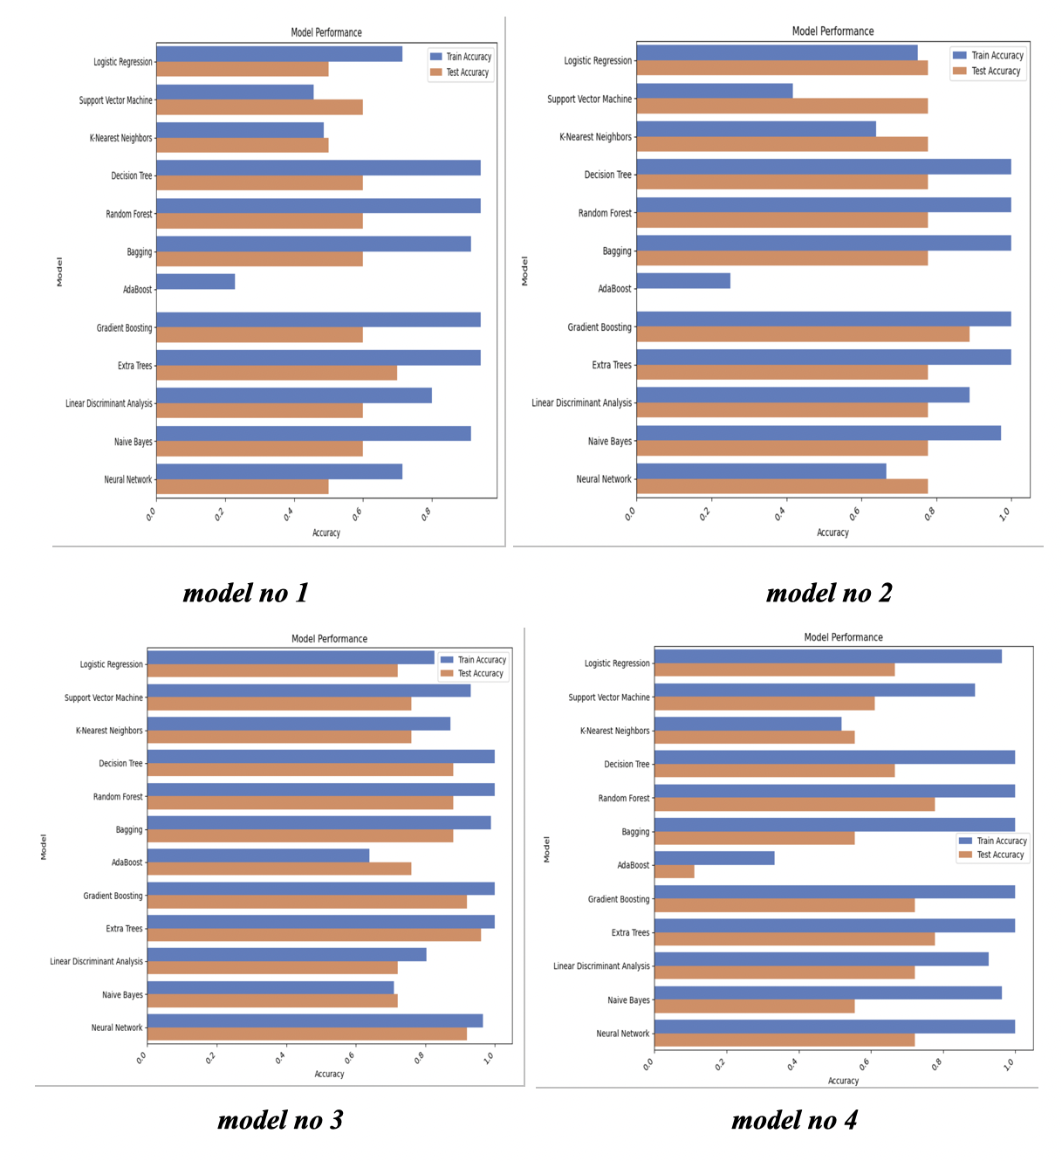
Accuracy Comparison of algos

Slide 46
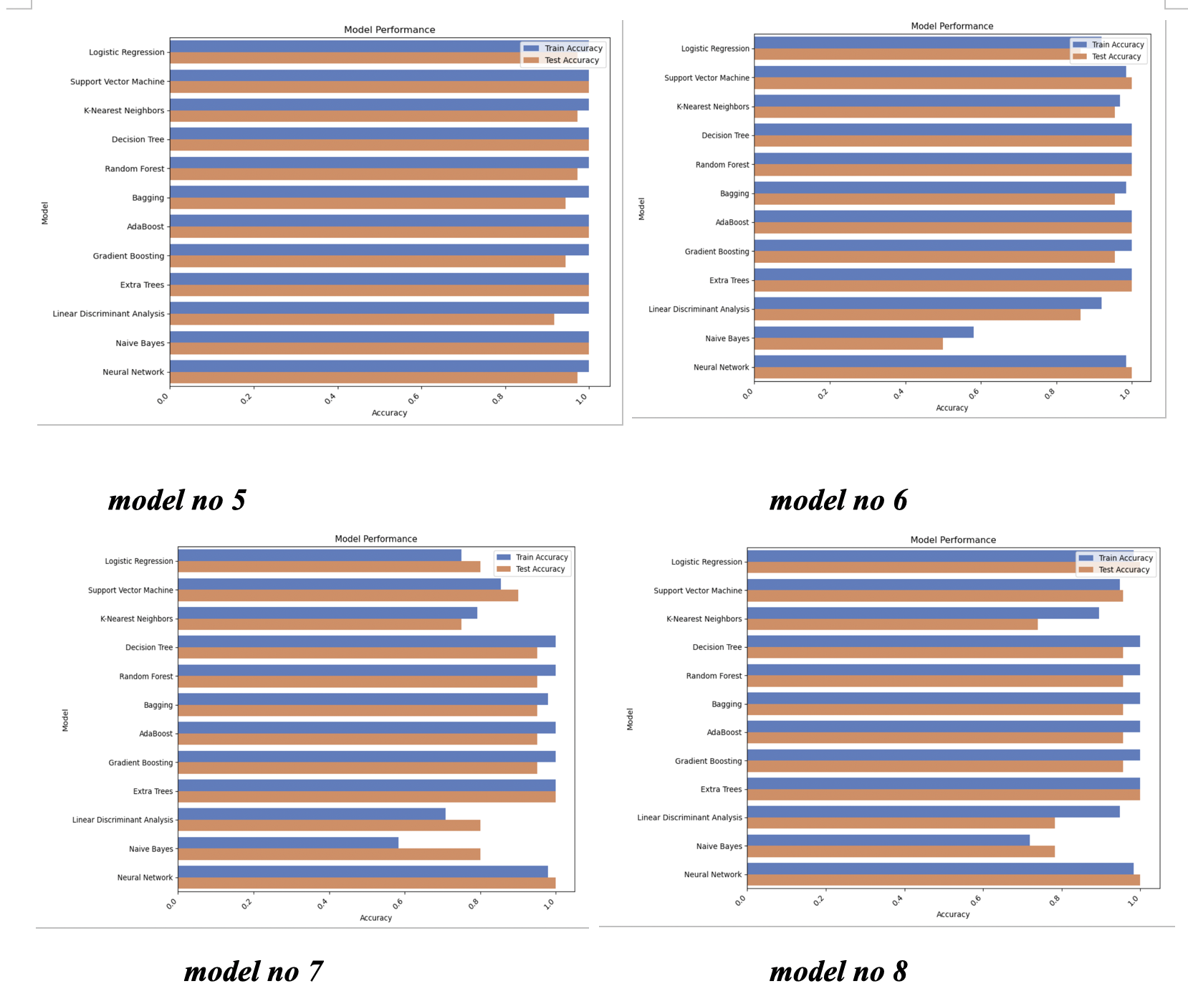
Continued

Slide 47
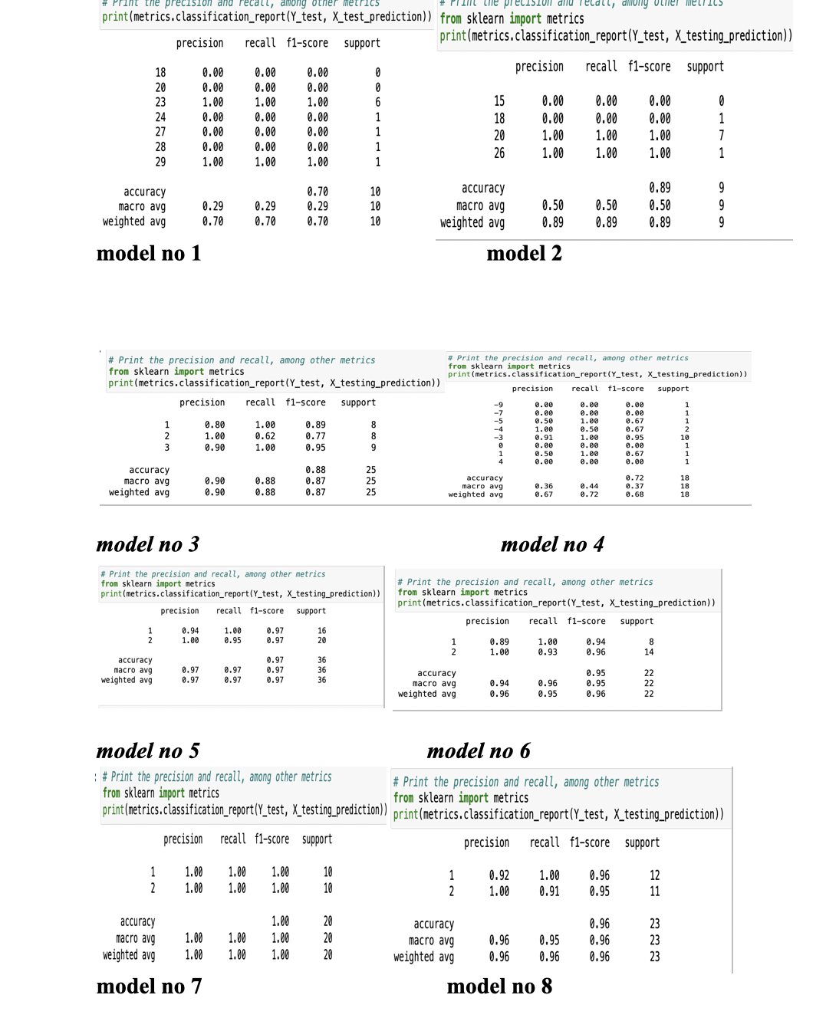
Classification Scores for all models….

Slide 48
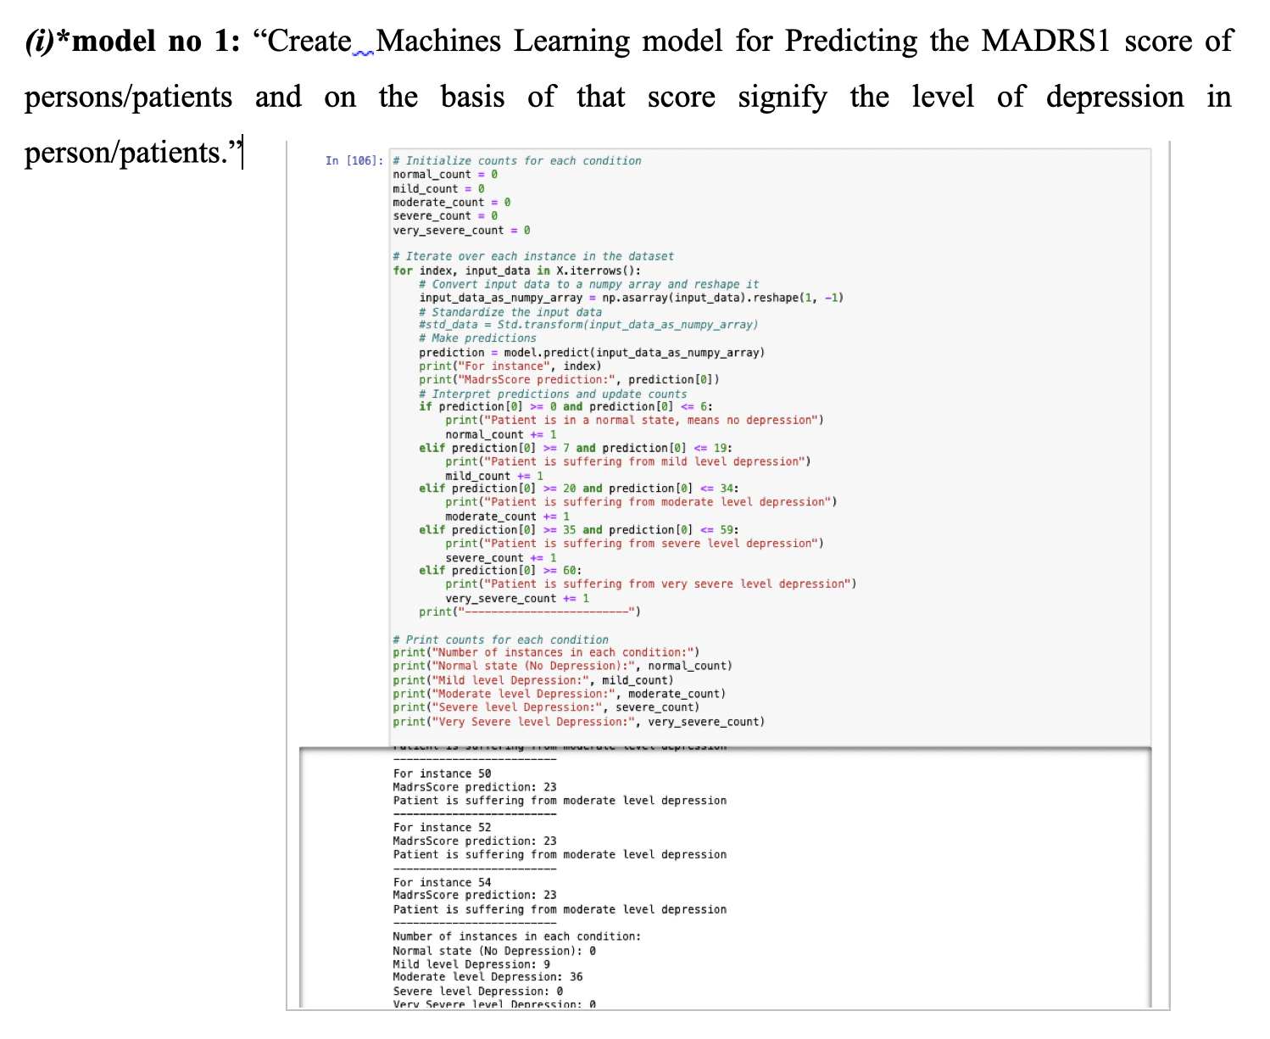
Input & output

Slide 49
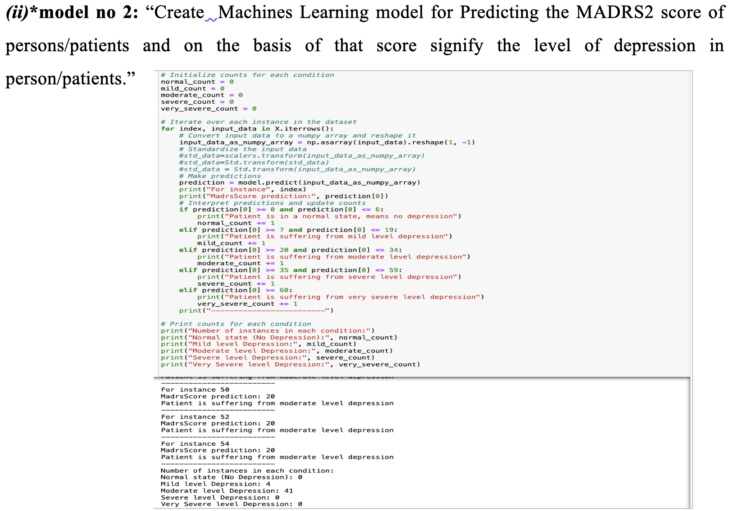
Continued...

Slide 50
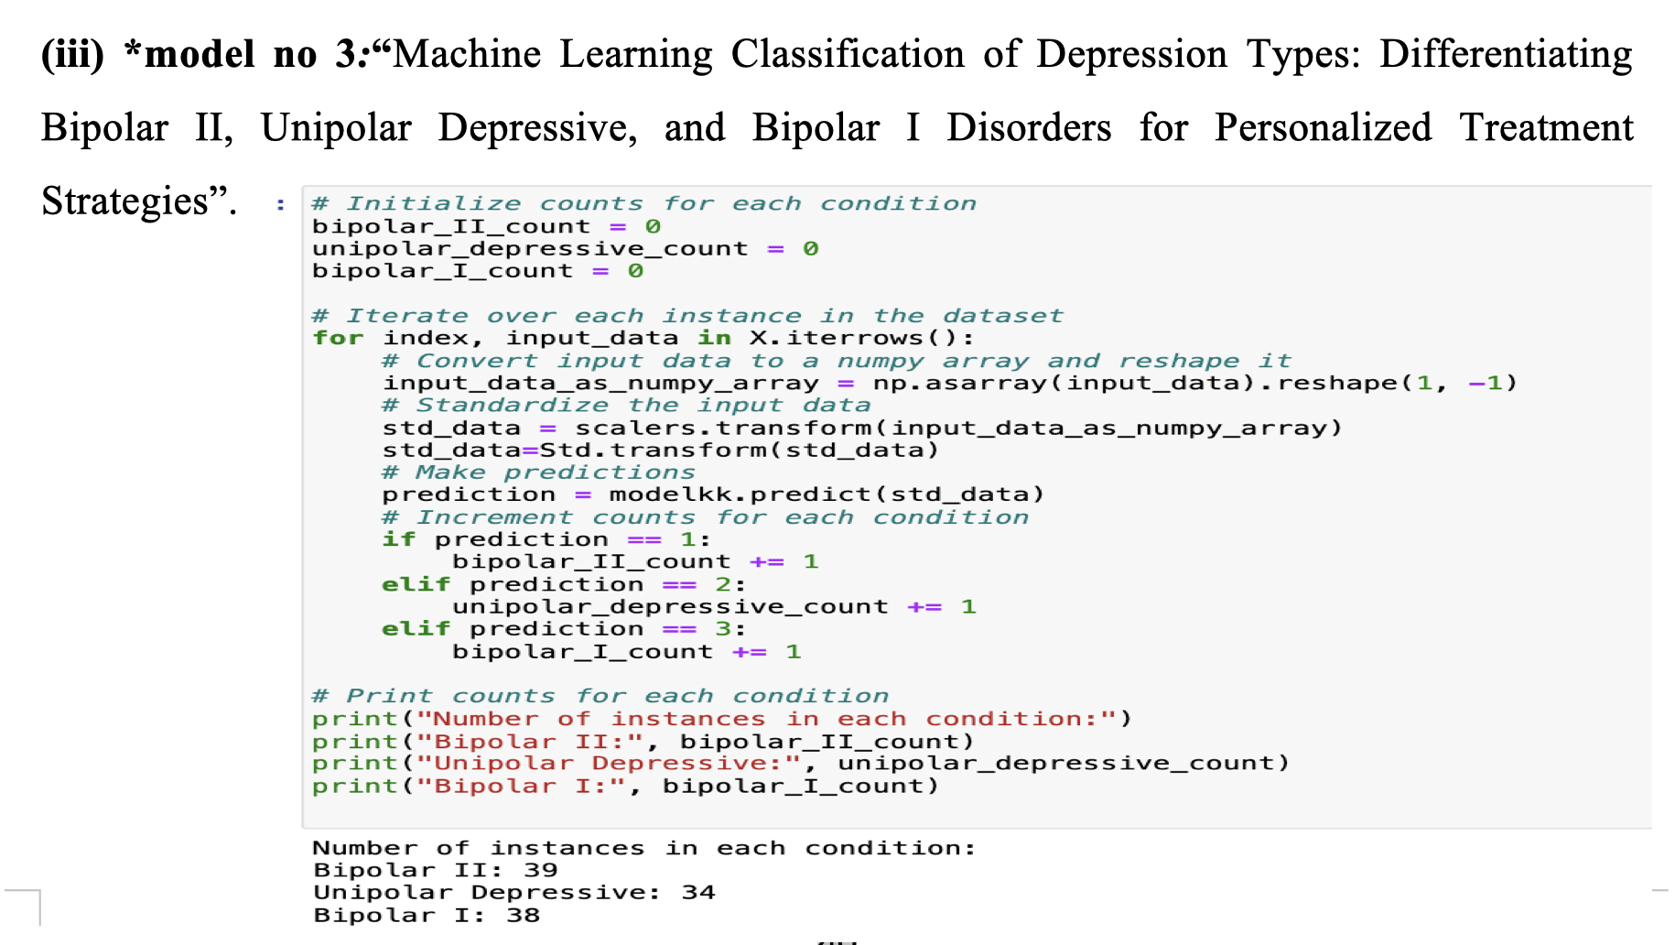
Continued..

Slide 51
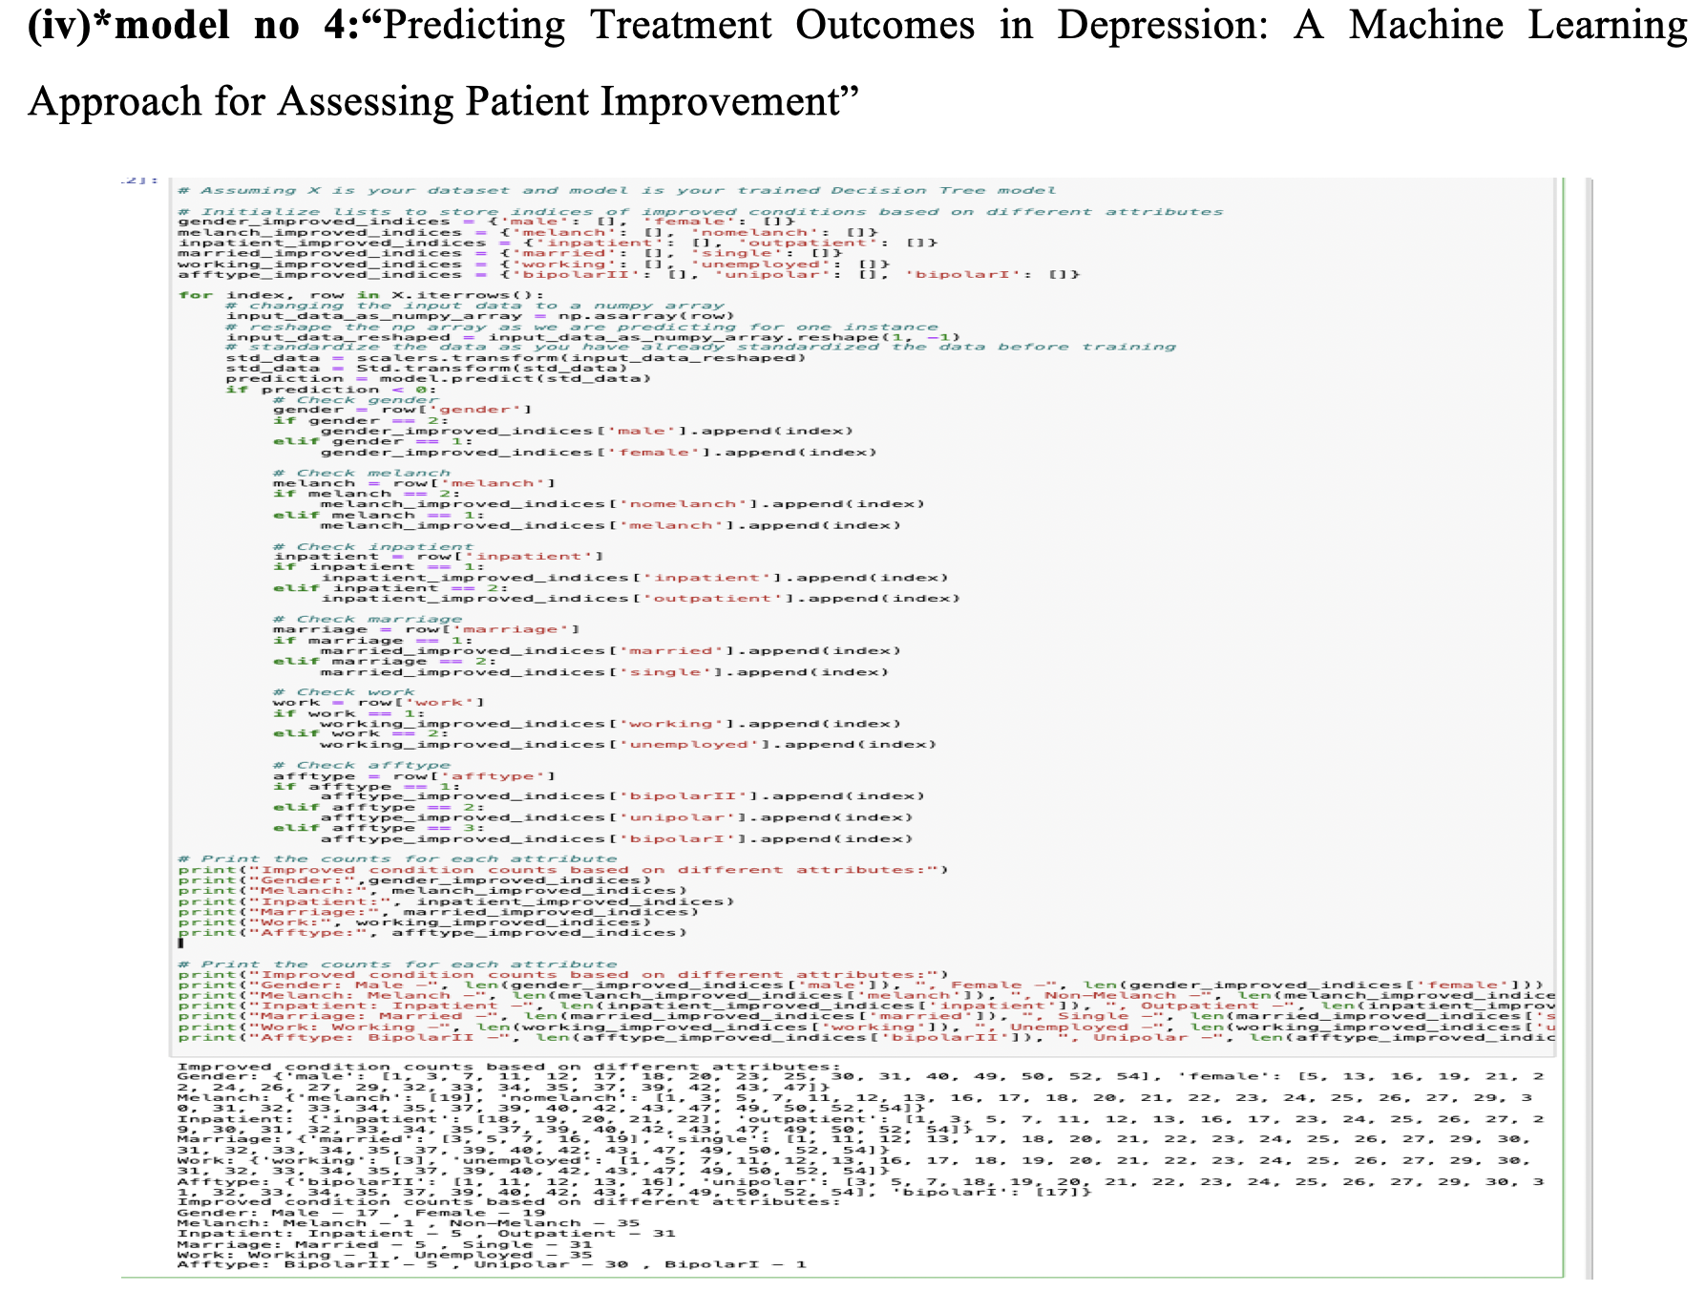
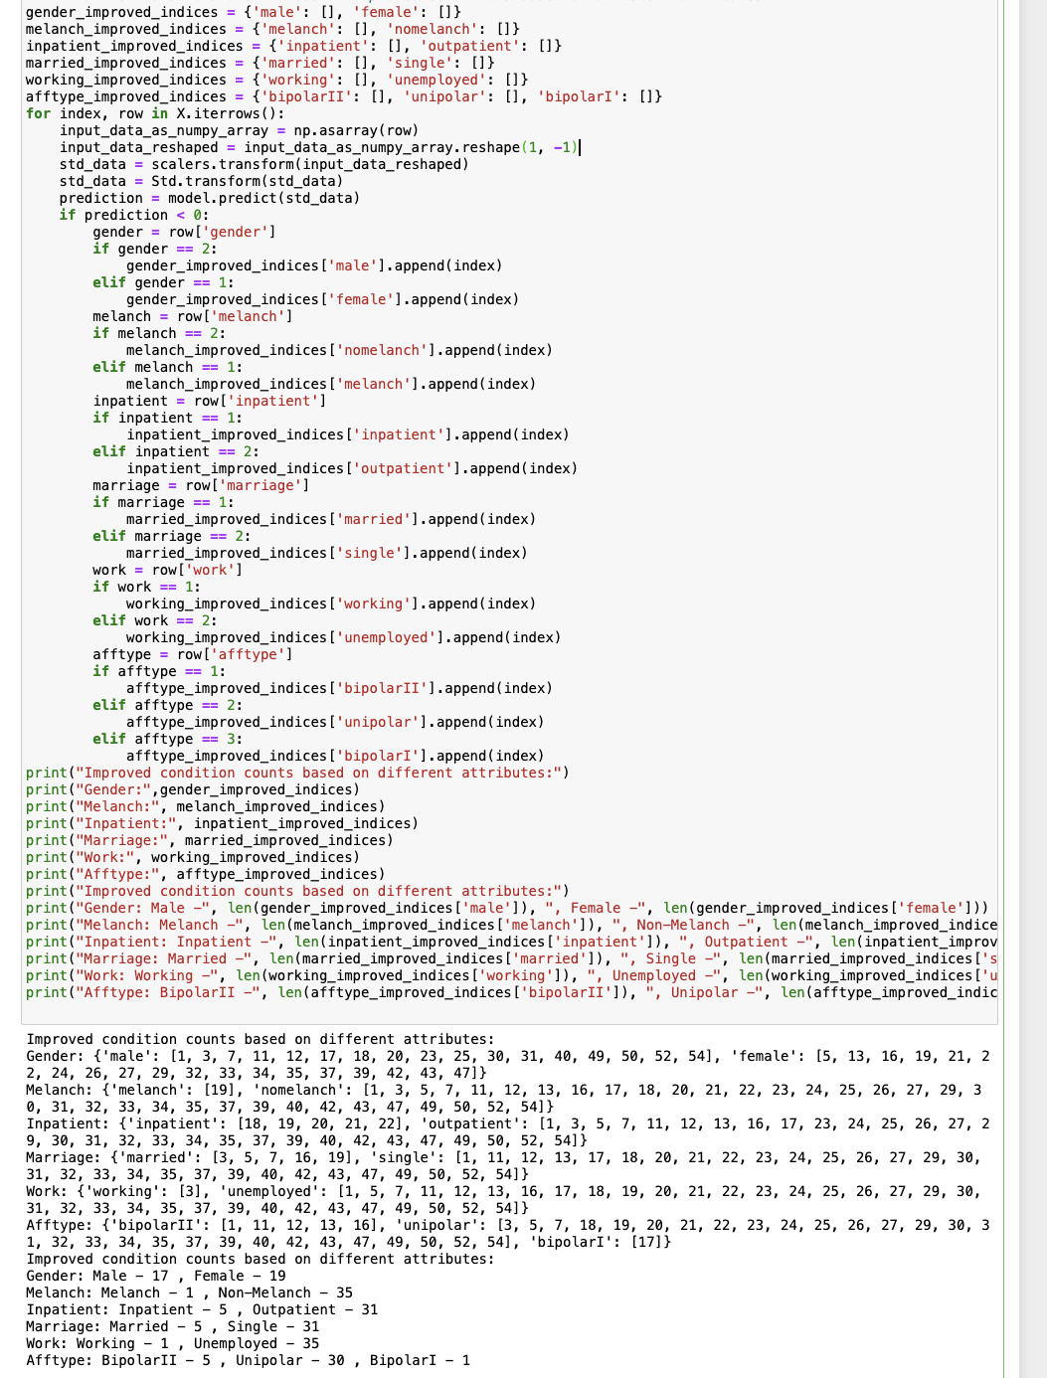
Continued...

Slide 52
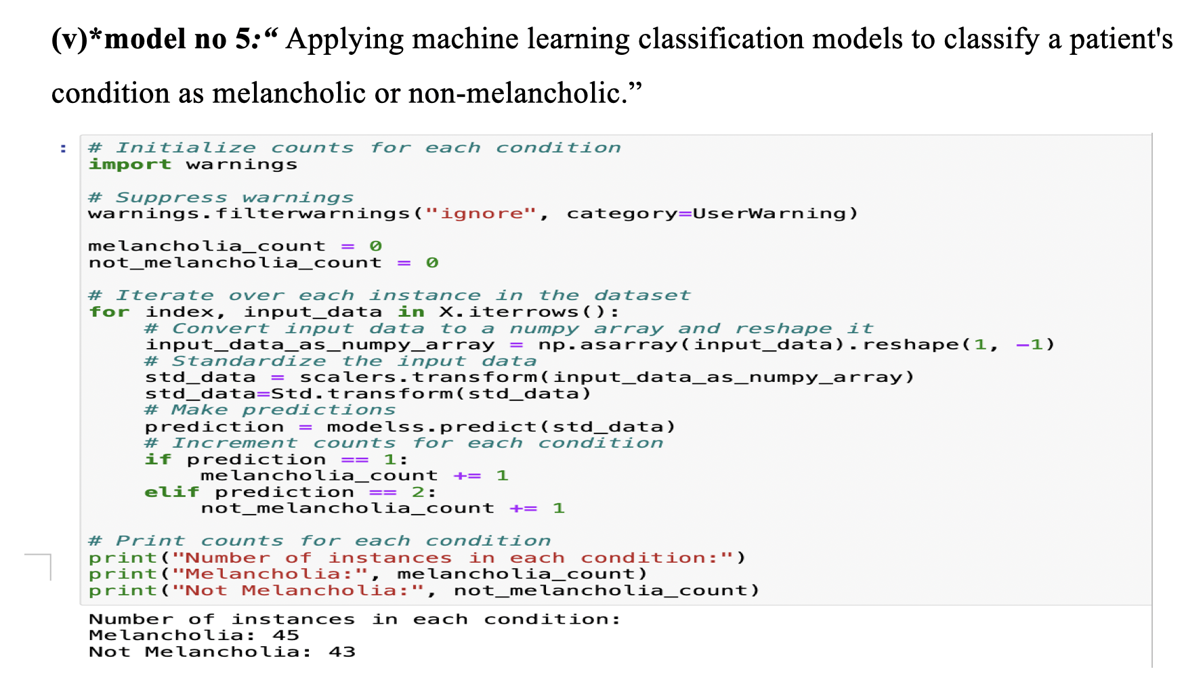
Continued..

Slide 53
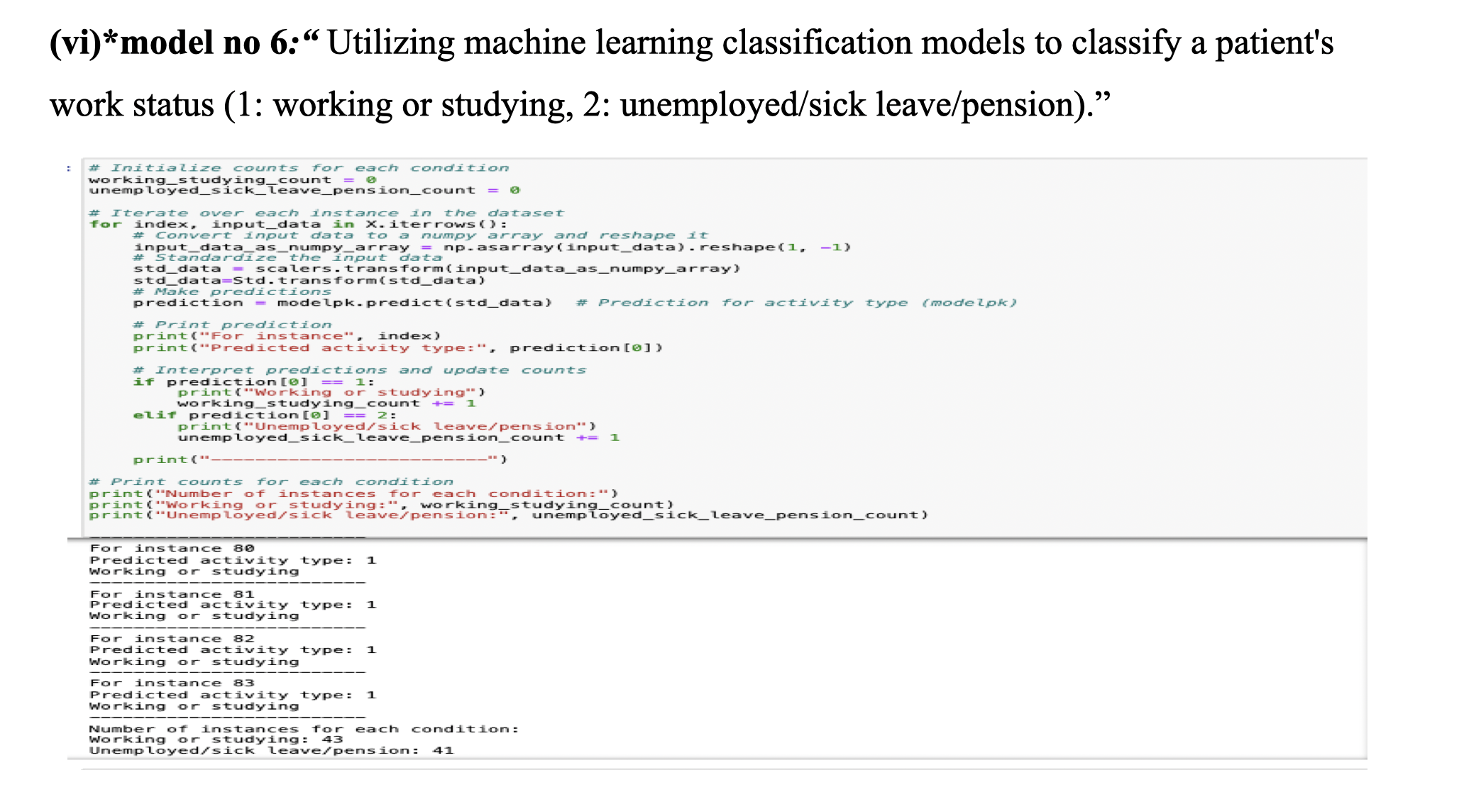
Continued..

Slide 54
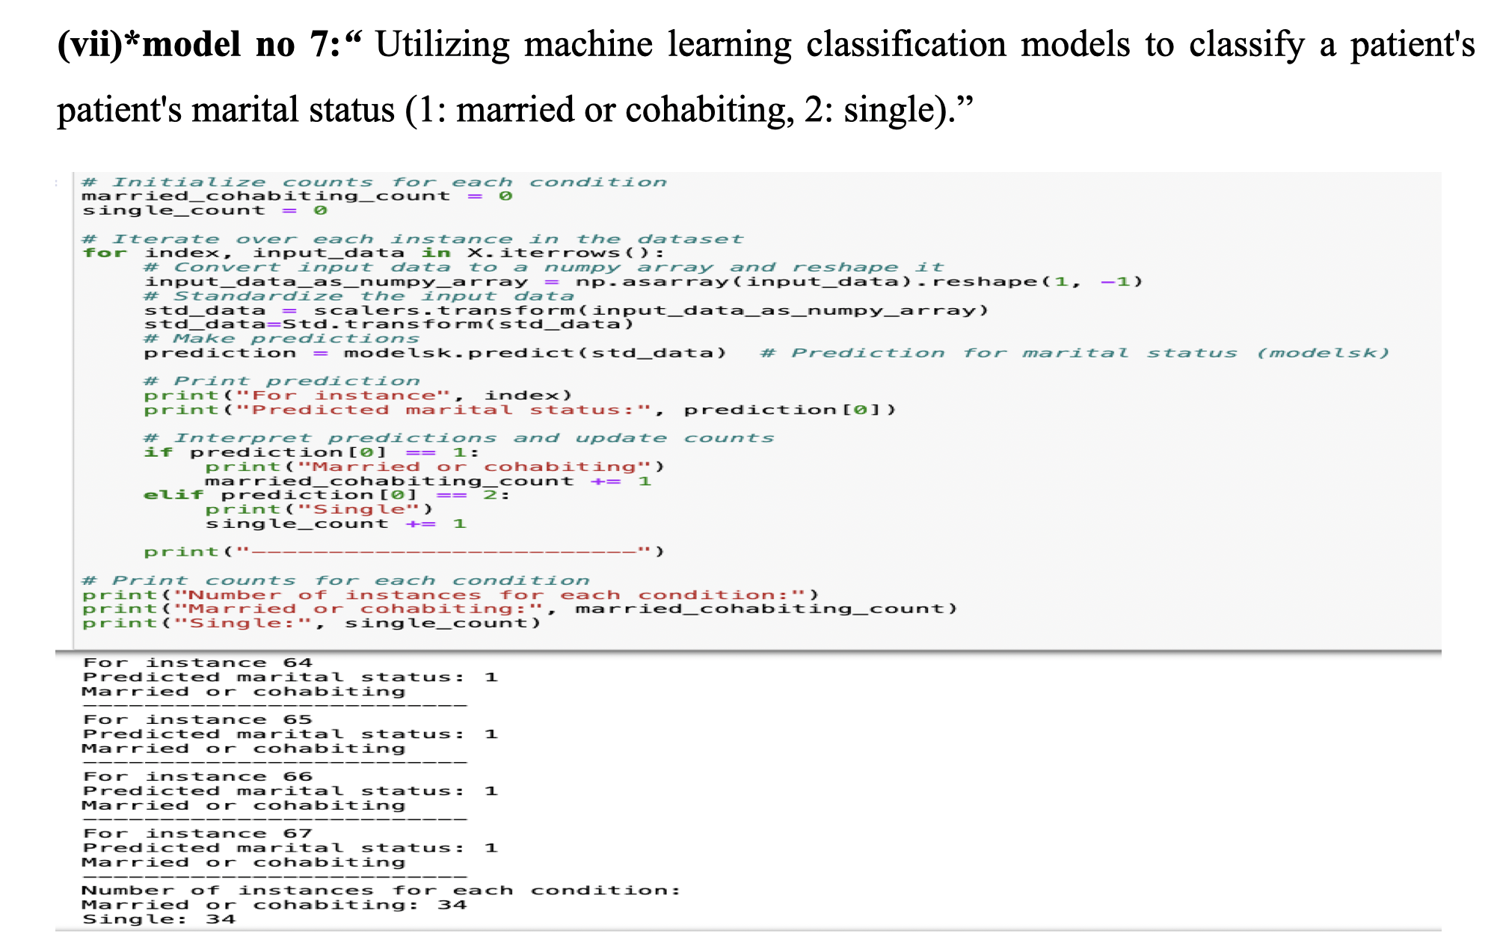
Continued..

Slide 55
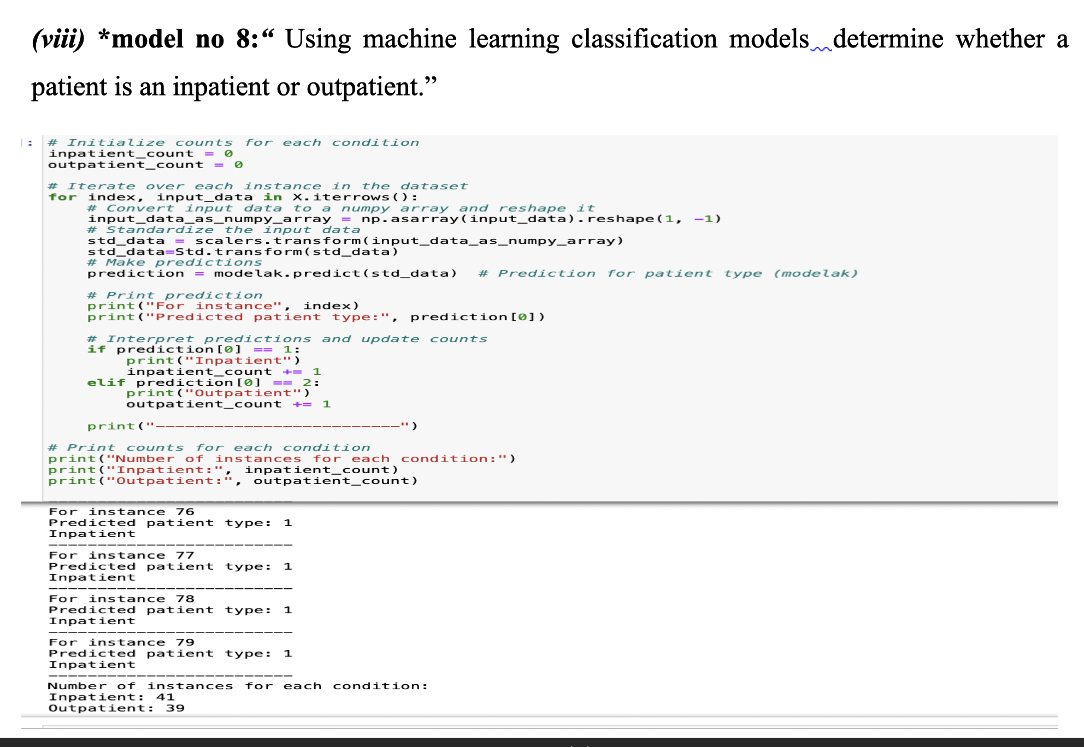
Continued..

Slide 56
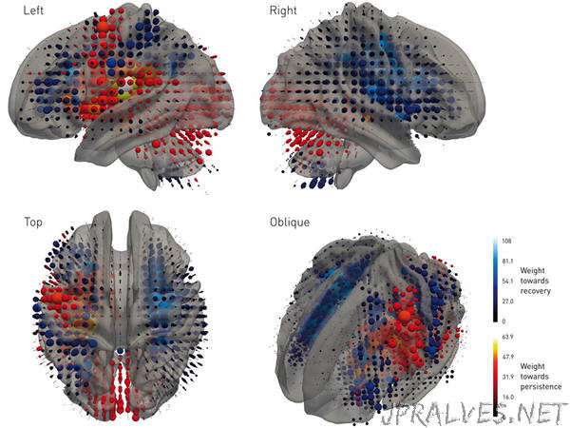
Results
for model number 1 the best algorithms is DecisionTreeClassifier and it give the accuracy around 94% on training and 70% on testing data.
for model number 2 the best algorithms is GradientBoostingClassifier and it give the accuracy around 100% on training data and 89% on testing data.
for model number 3 the best algorithms is DecisionTreeClassifier and it give the accuracy around 100% on training data and 94% on testing data.
for model number 4 the best algorithms is RandomForestClassifier and it give the accuracy around 100% on training data and 78% on testing data.
for model number 5 the best algorithms is RandomForestClassifier and it give the accuracy around 100% on training data and 98% on testing data.
for model number 6 the best algorithms is DecisionTreeClassifier and it give the accuracy around 100% on training data and 95% on testing data.
for model number 7 the best algorithms is DecisionTreeClassifier and it give the accuracy around 100% on training data and 100% on testing data.
for model number 8 the best algorithms is DecisionTreeClassifier and it give the accuracy around 100% on training data and 96% on testing data.

Slide 57
continued..
Based on the predictions of the machine learning models on the existing original dataset, the following observations were made:
1. Model 1 predicted:
• Number of patients suffering from mild-level depression: 9
• Number of patients suffering from moderate-level depression: 36
This indicates that the number of patients with moderate-level depression is greater than those with mild-level depression.
2. Model 2 predicted:
• Number of patients suffering from mild-level depression: 4
• Number of patients suffering from moderate-level depression: 41
Again, the number of patients with moderate-level depression exceeds those with mild-level depression.
3. Model 3 predicted:
• Number of patients suffering from Bipolar II: 39
• Number of patients suffering from unipolar Depressive: 41
• Number of patients suffering from Bipolar I: 38
This suggests that the number of patients with unipolar depressive disorder is greater than those with Bipolar II and Bipolar I.
4. Model 4 predicted improvements based on different attributes:
• Gender: Male - 17, Female - 19
• Melancholia: Melancholic - 1, Non-Melancholic - 35
• Inpatient: Inpatient - 5, Outpatient - 31
• Marriage: Married - 5, Single - 31
• Work: Working - 1, Unemployed - 35
• Afftype: Bipolar II - 5, Unipolar - 30, Bipolar I - 1
This indicates variations in improvement across different attributes such as gender, melancholic/non-melancholic status, patient status (inpatient/outpatient), marital status, employment status, and depression type.

Slide 58
continued...
5. Model 5 predicted:
• Number of patients suffering from Melancholia: 45
• Number of patients suffering from Not Melancholia: 43
This suggests that the number of patients with melancholia is greater than those without melancholia.
6. Model 6 predicted:
• Number of patients belonging to Working or studying group: 43
• Number of patients belonging to Unemployed/sick/leave/pension group: 41
This indicates that the number of patients who are working or studying is greater than those who are unemployed.
7. Model 7 predicted:
• Number of patients belonging to Married group: 34
• Number of patients belonging to Single group: 34
This suggests an equal distribution of patients between the married and single groups.
8. Model 8 predicted:
• Number of patients belonging to Inpatient group: 41
• Number of patients belonging to Outpatient group: 34
This indicates that the number of patients in the inpatient group is greater than those in the outpatient group.

Slide 59
Continued
General Observations:
->DecisionTreeClassifier consistently delivered exceptional results across diverse models.
->RandomForestClassifier demonstrated robust performance in predicting treatment outcomes.
->The adaptability and efficacy of selected algorithms emphasize their suitability for mental health assessment tasks.
->Results provide insightful information for individualized treatment plans, patient status, and welfare.

Slide 60
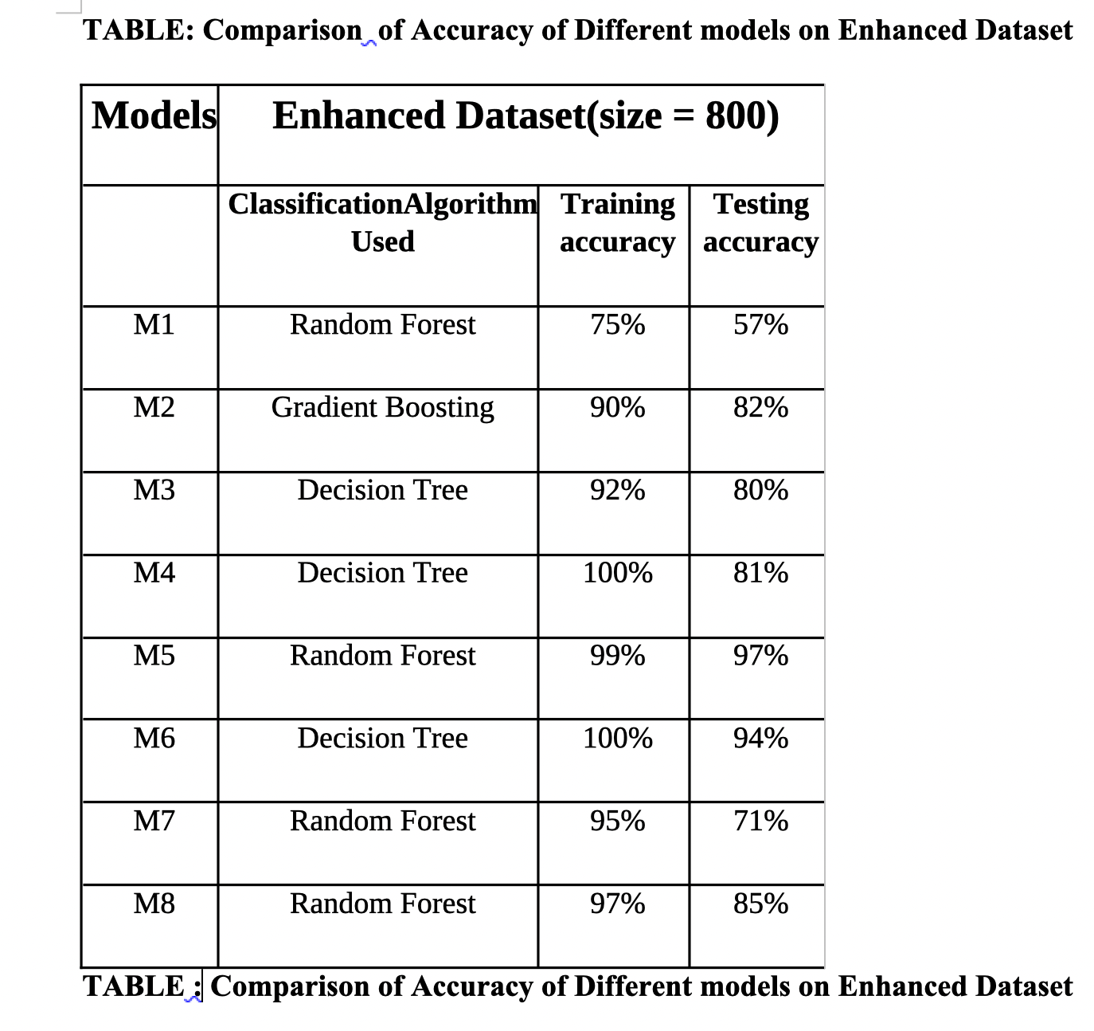
Continued....

Slide 61
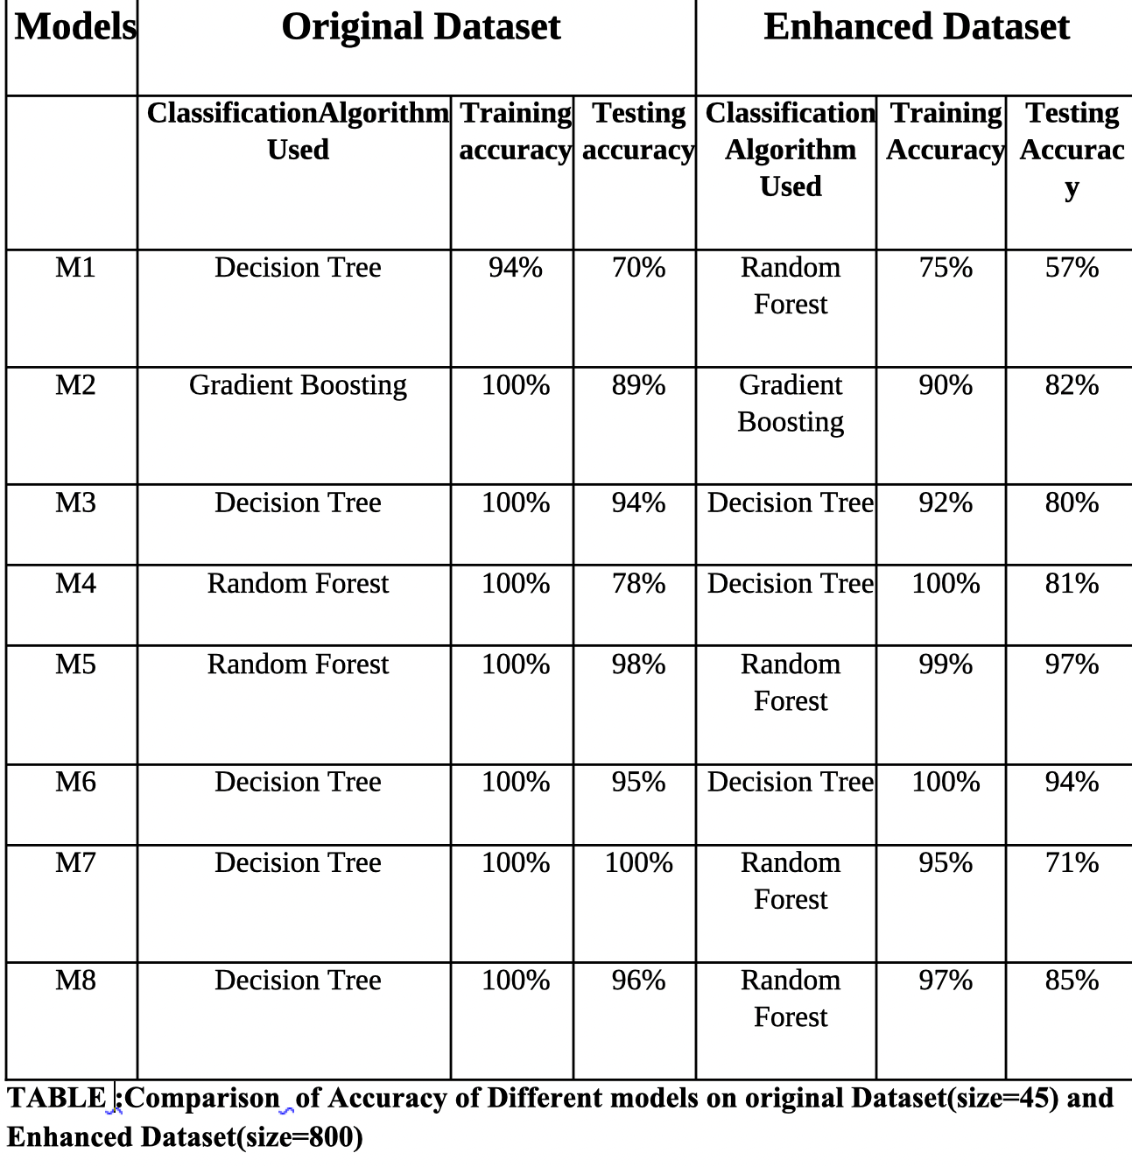
continued

Slide 62
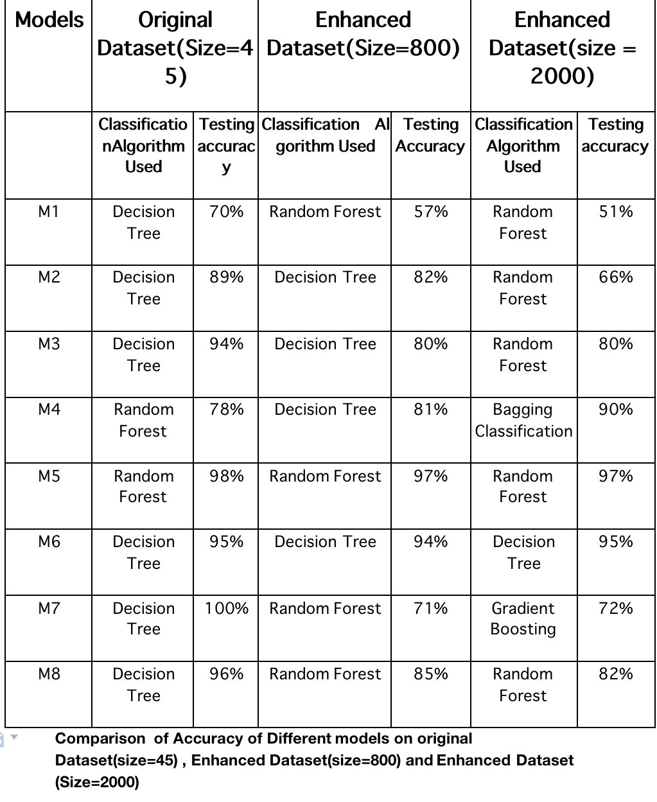
Continued.

Slide 63

Conclusion
1. High Forecasting Success:
- The machine learning models demonstrated a high degree of success in forecasting various aspects of depression.
2. Key Models - DecisionTree and RandomForest:
- DecisionTreeClassifier and RandomForestClassifier, in particular, showed impressive accuracy across different tasks.
3. Accuracy in Depression Severity Prediction:
- Achieved remarkable accuracy in predicting depression severity levels.
4. Effective Subtype Differentiation:
- Successfully differentiated between depression subtypes, such as bipolar II, unipolar, and bipolar I disorders.
5. Accurate Patient Categorization:
- Efficiently categorized patients based on various factors, including marital and employment status.

Slide 64

6.Insights from the Original Data:
When I looked at the original data, I found that a lot of people had moderate-level depression, and most of them had a type of depression called unipolar depression.
7.Enhanced Dataset:
I made my dataset bigger by adding more data using a special technique called Genetic Algorithm Cross Over. This helped me to understand depression better.
8. Machine Learning's Impact on Mental Health:
- Highlights the significant impact of machine learning in offering insightful information about mental health conditions.
9. Contribution to Early Intervention:
- Predicting and categorizing different aspects of depression can greatly aid in early diagnosis, leading to more effective and personalized interventions.
10.Overall Positive Outlook:
- The overall positive outcomes emphasize the promising role of machine learning in advancing mental health research and clinical applications.
- My findings show that machine learning can help to understand depression better, which can help doctors diagnose it early and plan better treatments.
- Overall, my study helps to understand depression more deeply, which can lead to better ways to help people who are struggling with it.

Slide 65

References
1. Walsh, L., Giggins, O. M., Clay, I., & McDonnell, C. (2018). A novel method for gait rehabilitation utilizing wearable lower limb haptic feedback. *Journal of Rehabilitation Medicine, 50*(4), 342-349.
2. Osmani, V. (2015). Smartphone-based approach for detecting periods of mania and depression. *Journal of Mobile Technology in Medicine, 4*(3), 16-25.
3. Schueller, S. M., Corden, M. E., Kording, K. P., Zhang, M., Karr, C. J., Saeb, S., & Mohr, D. C. (2015). Exploratory study on the relationship between depressive symptoms and mobile phone sensor data. *Journal of Mobile Health, 2*(1), 28-37.
4. Davatzikos, C., & Koutsouleris, N. (2014). Application of machine learning for psychiatric disease classification. *NeuroImage, 90*, 1-9.
5. Onaral, B., & Xing, D. (2012). The patient's perspective on wearable and implantable sensors. *Journal of Wearable Technology, 1*(1), 14-22.
6.https://datasets.simula.no/depresjon
7.https://bmcresnotes.biomedcentral.com/articles/10.1186/1756-0500-3-149
8.https://www.ncbi.nlm.nih.gov/books/NBK409740/#:~:text=Montgomery%E2%80%93%C3%85sberg%20Depression%20Rating%20Scale,-Next%20to%20the&text=This%20scale%20is%20clinician%2Drated,indicative%20of%20greater%20depressive%20symptomology.
9.https://www.medicalnewstoday.com/articles/unipolar-depression
10.https://www.verywellmind.com/common-types-of-depression-1067313
11.https://www.mayoclinic.org/diseases-conditions/depression/diagnosis-treatment/drc-20356013
12.https://www.javatpoint.com/machine-learning-decision-tree-classification-algorithm

Slide 66

THANK YOU

